Slide 1
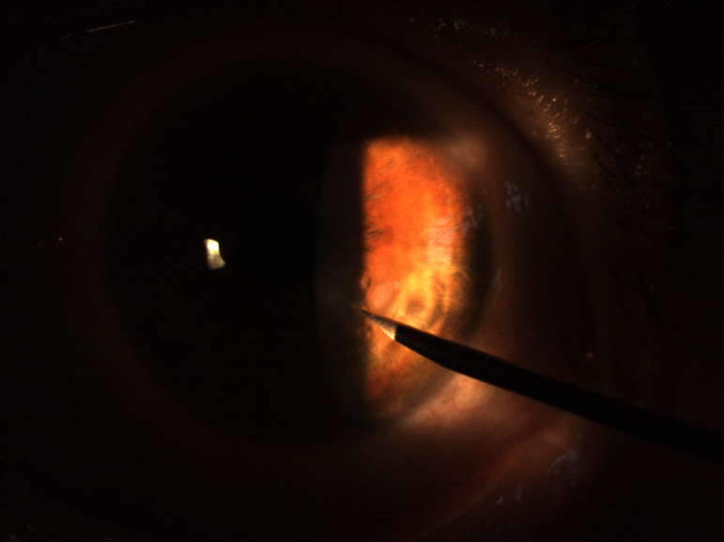
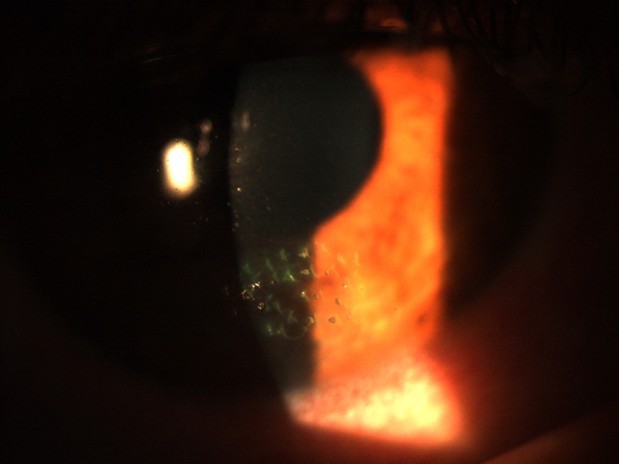

STROMAL PUNCTURE TREATMENT FOR CORNEAL EPITHELIAL BASAL MEMBRANE TRAUMAS
Bora Yüksel
U. Duygu Uzunel
Tuncay Küsbeci
Izmir Bozyaka Education and Research Hospital

Slide 2
Purpose: To present the results of stromal puncture treatment for corneal epithelial basal membrane traumas.
Material and Method: 2 Male, 4 female patients diagnosed and treated between March 2013- February 2015 in our Cornea department were enrolled. Mean age was 42.5 (22-61). All patients presented with pain and discomfort persisting for several months. Best corrected visual acuity was between counting fingers (CF) and 20/100.
On slit lamp examination, large epithelial bullae were noticed in the lower half of the cornea. Causes of trauma were paper, firewood, fist and nail injury. A Nd:YAG laser stromal puncture was performed in one patient. 26G insulin needle was used in others. Topical antibiotics and artificial tears were given after the procedure. A soft bandage contact lens was applied in 2 cases. Mean follow-up was 10.5 (range, 4-24) months.

Slide 3
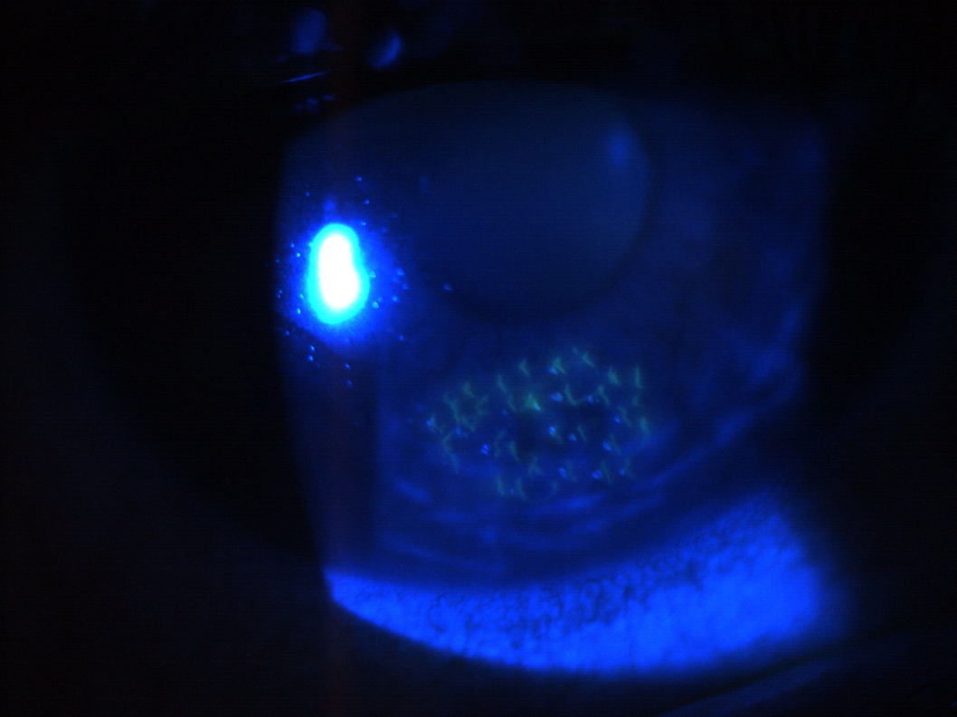
RESULTS
Epithelial bullae recurred in 1 patient who had Nd:YAG laser stromal puncture earlier. A needle puncturing was performed and complete cure was achieved in that patient
BCVA improved from CF at four meters to 20/20. Full recovery was achieved in the rest of the eyes
The epithelium was attached and the ocular surface was smooth
Visual acuity improved to 20/20 in all cases with no recurrence during follow-up

Slide 4
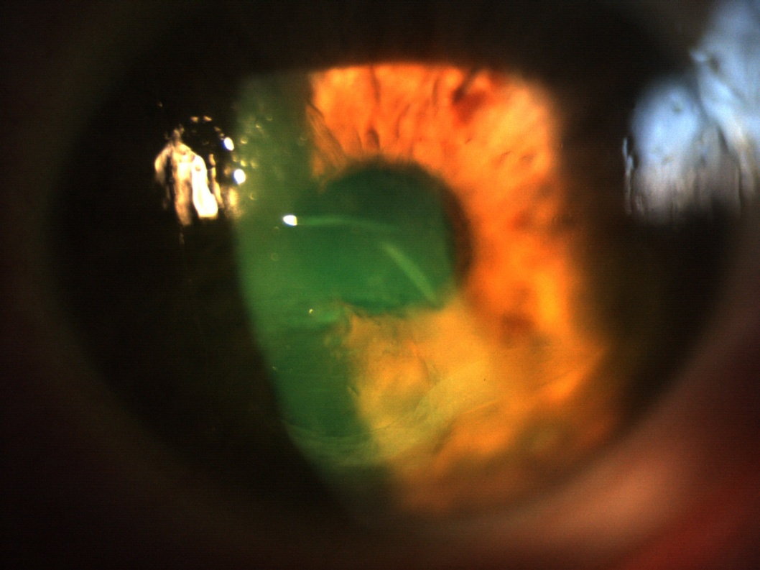
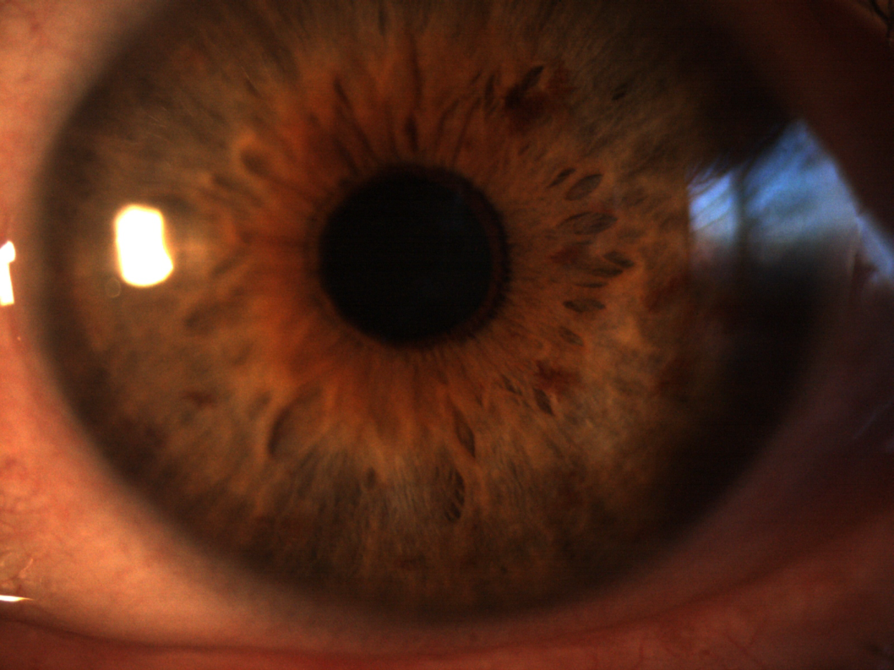
Female (61) Paper injury 6 months ago
VA: CF at 3 meters
Six months after stromal puncture. VA: 20/20

Slide 5
CONCLUSION
These cases are usually unrecognized on cursory examination. So that, patients suffer pain and discomfort for several months despite lubrication and other treatments
Stromal puncturing with a needle or Nd:YAG laser is a safe and effective treatment that provides patients with the relief of the symptoms, reattachment of the epithelium and reestablishement of a healthy ocular surface.
Thank you!

